Slide 1
PROBE

Slide 2
Showing up
Who do I choose to show up as?
At my best
At my worst
As just enough

Slide 3
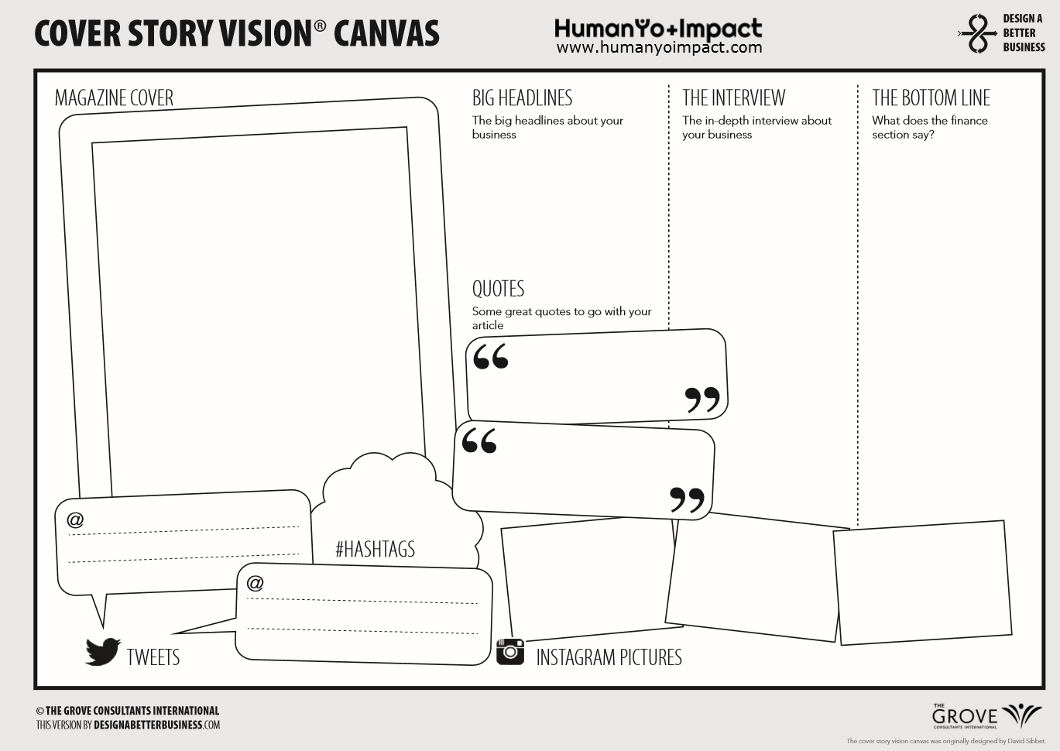

At my best: What’s my story?
Events
Roles & Responsibilities
Results
Notes:
To be re-created more personally

Slide 4
At my worst: What’s my story?
Events
Roles & Responsibilities
Results
Notes:
To be re-created more personally

Slide 5
Is there judgement in the way you see yourself?

Slide 6
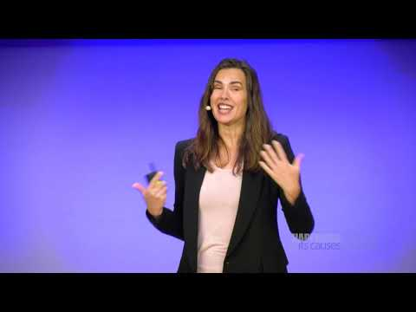
Notes:
“Loving connected presences”

Slide 7
Is perfectionism showing up for you?

Slide 8
“Everyone is imperfect
and everyone lives an imperfect life…”

Slide 9
Self compassion
“Treating yourself like you would treat a close friend who was struggling”

Slide 10
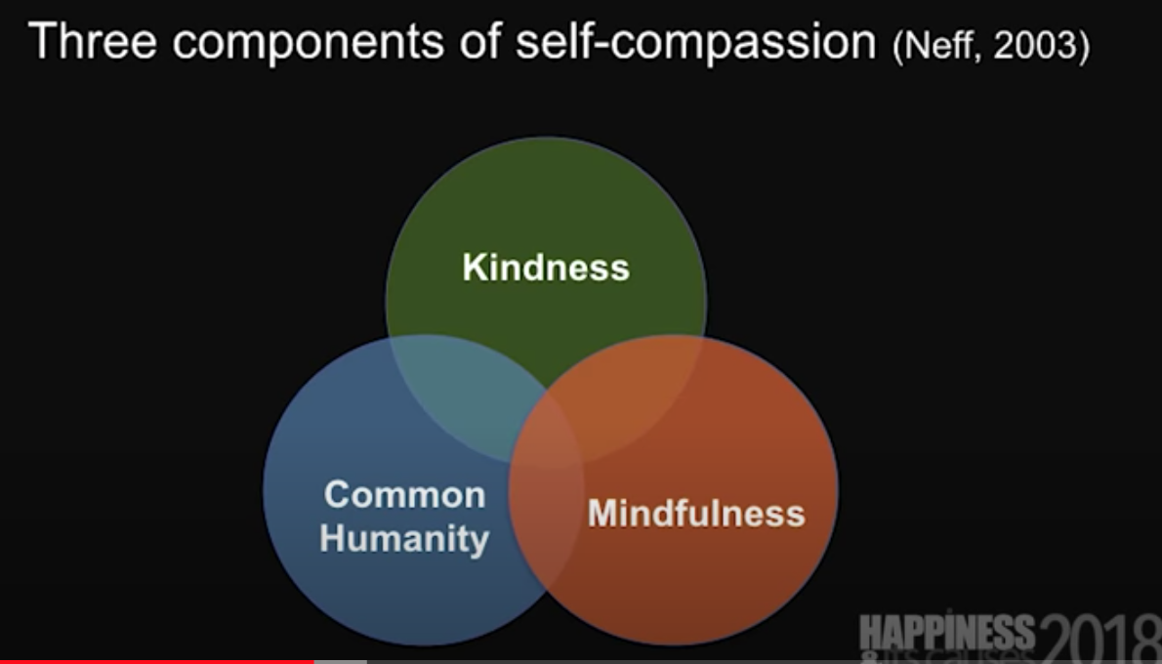

Slide 11
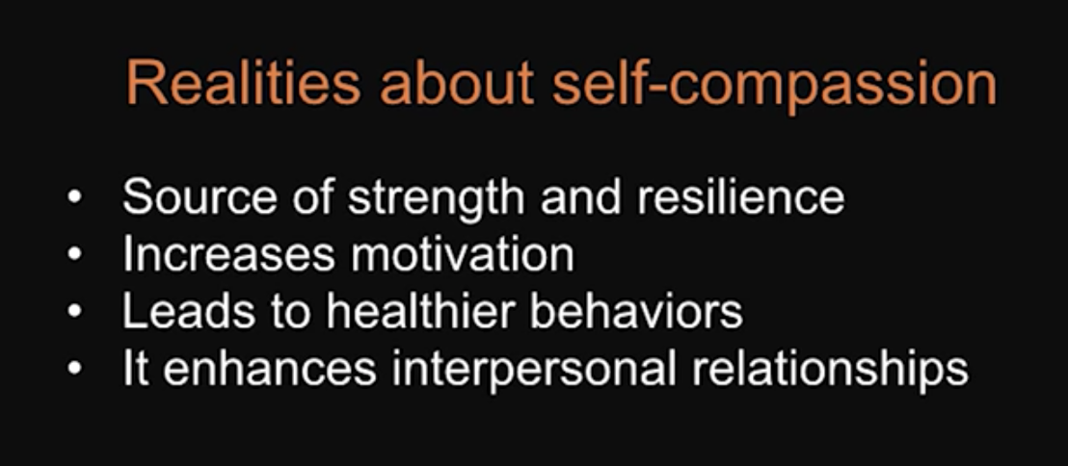
“If I fail,
I will still accept myself.”

Slide 12
Is this how you would speak with a friend?

Slide 13
What does good enough look like?

Slide 14
Worst
Enough
Best

Slide 15
At just enough: What’s my compassionate story?
Events
Roles & Responsibilities
Results
Notes:
To be re-created more personally

Slide 16
How I roll

Slide 17
Rituals
Habits
Priorities
Notes:
How might you establish a practice with self compassion and equanimity?

Slide 18
Catch yourself: 5, 4, 3, 2, 1
Refocus on objective

Slide 19
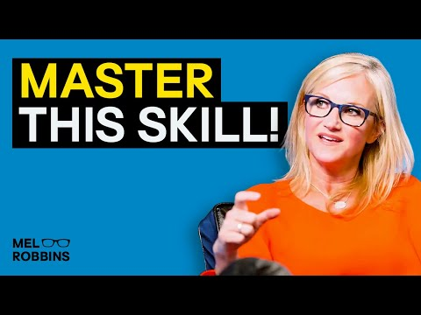
Notes:
Confidence- 5 second rule to create a new habit. https://www.youtube.com/watch?v=EFfcO3fdkuc
Grieve, learn and then make the intentional pivot to whats best for you next
Habits_ celebration n self confidence

Slide 20
Thresholds to pause, moments to reflect
(intention, action, impact)

Slide 21
Prime your brain with your intention: “I’m excited”

Slide 22
My people

Slide 23
[People map - who & why]

